Slide 1
Precise Analysis

Slide 2
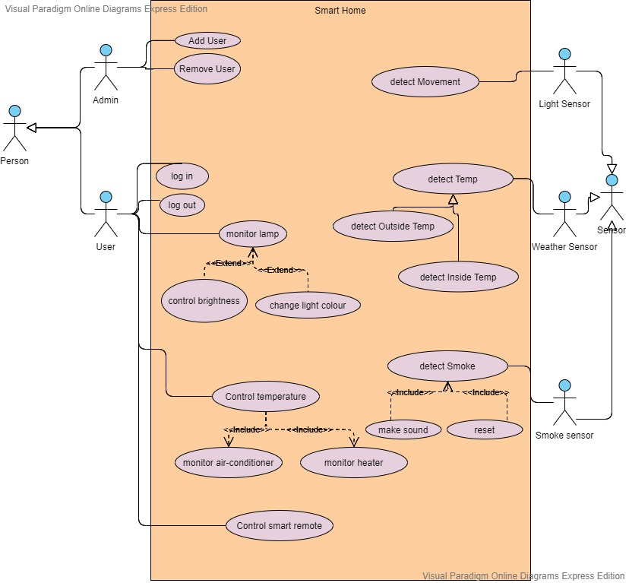
USE CASE DIAGRAM

Slide 3
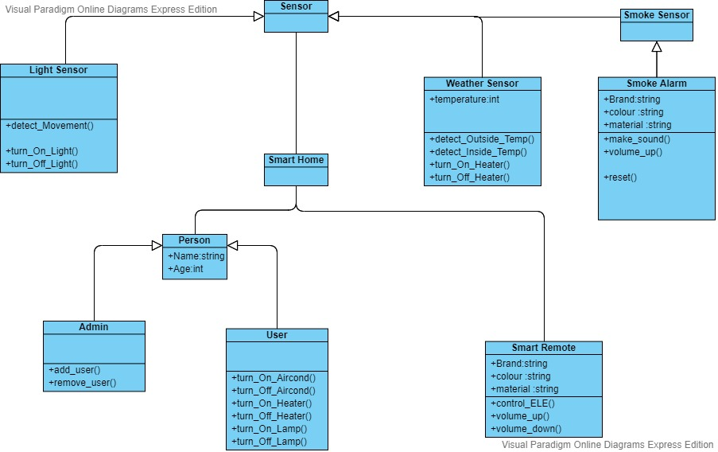
Class Diagram

Slide 4
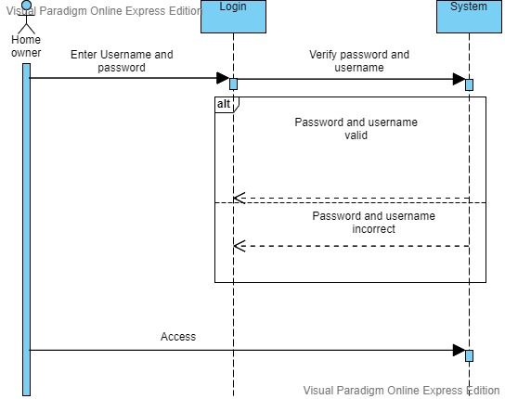
SEQUENCE DIAGRAM FOR LOGIN

Slide 5
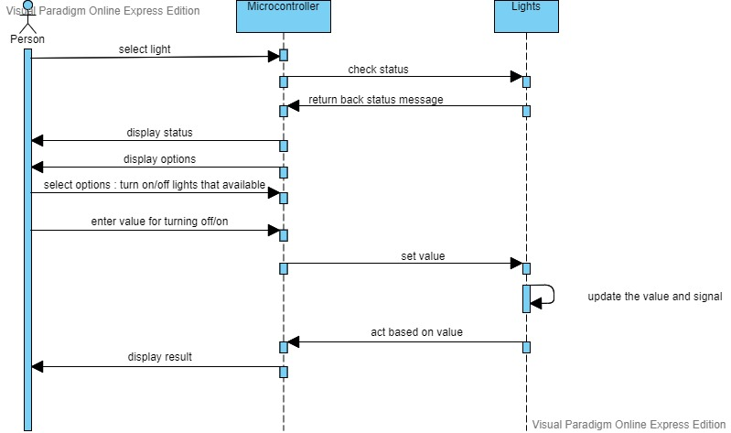
SEQUENCE DIAGRAM FOR CONTROLLING LIGHT

Slide 6
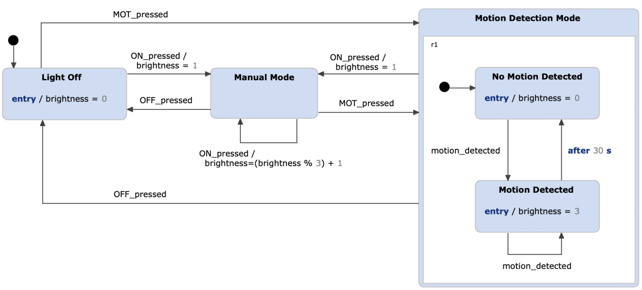
STATE DIAGRAM FOR LIGHT AND MOTION SENSOR

Slide 7
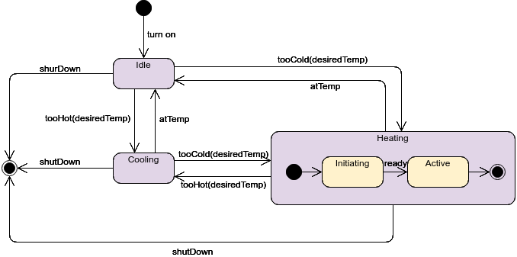
STATE DIAGRAM FOR HEATING/COOLING SYSTEM

Slide 8
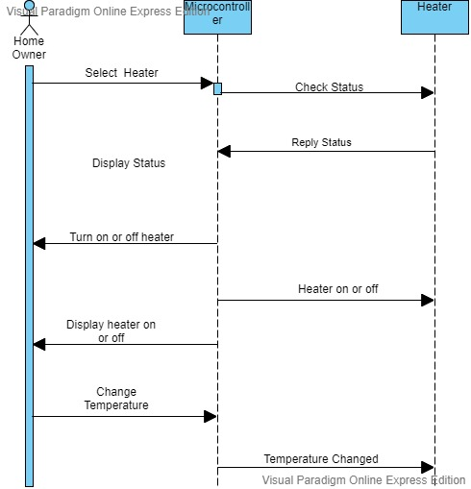
SEQUENCE DIAGRAM FOR HEATER

Slide 9
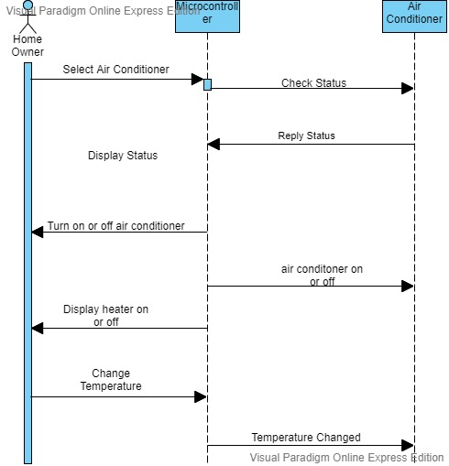
SEQUENCE DIAGRAM FOR AIR CONDITIONER

Slide 10
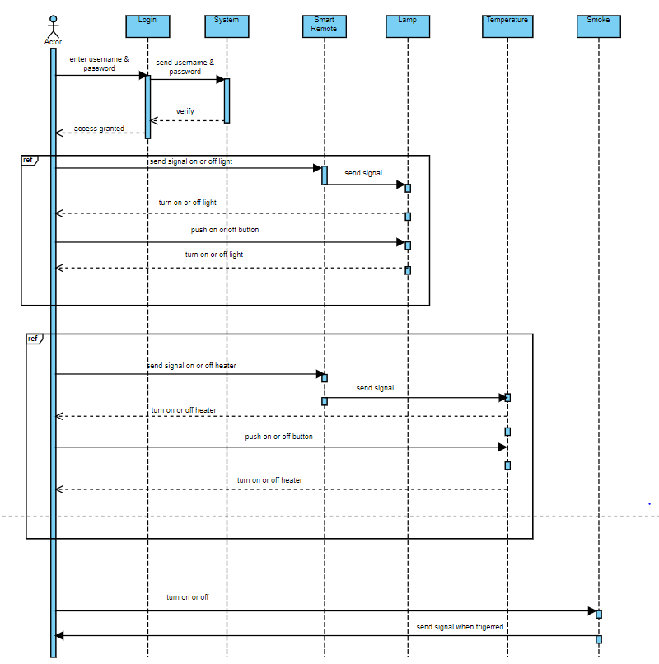
SEQEUNCE DIAGRAM FOR SMART REMOTE

Slide 11
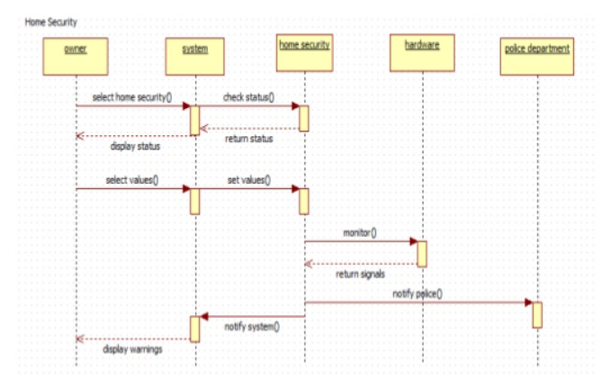
SEQUENCE DIAGRAM FOR SECURITY

Slide 12
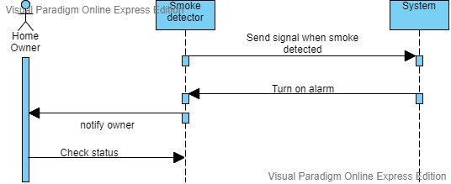
Sequence Diagram for Fire Alarm

Slide 13
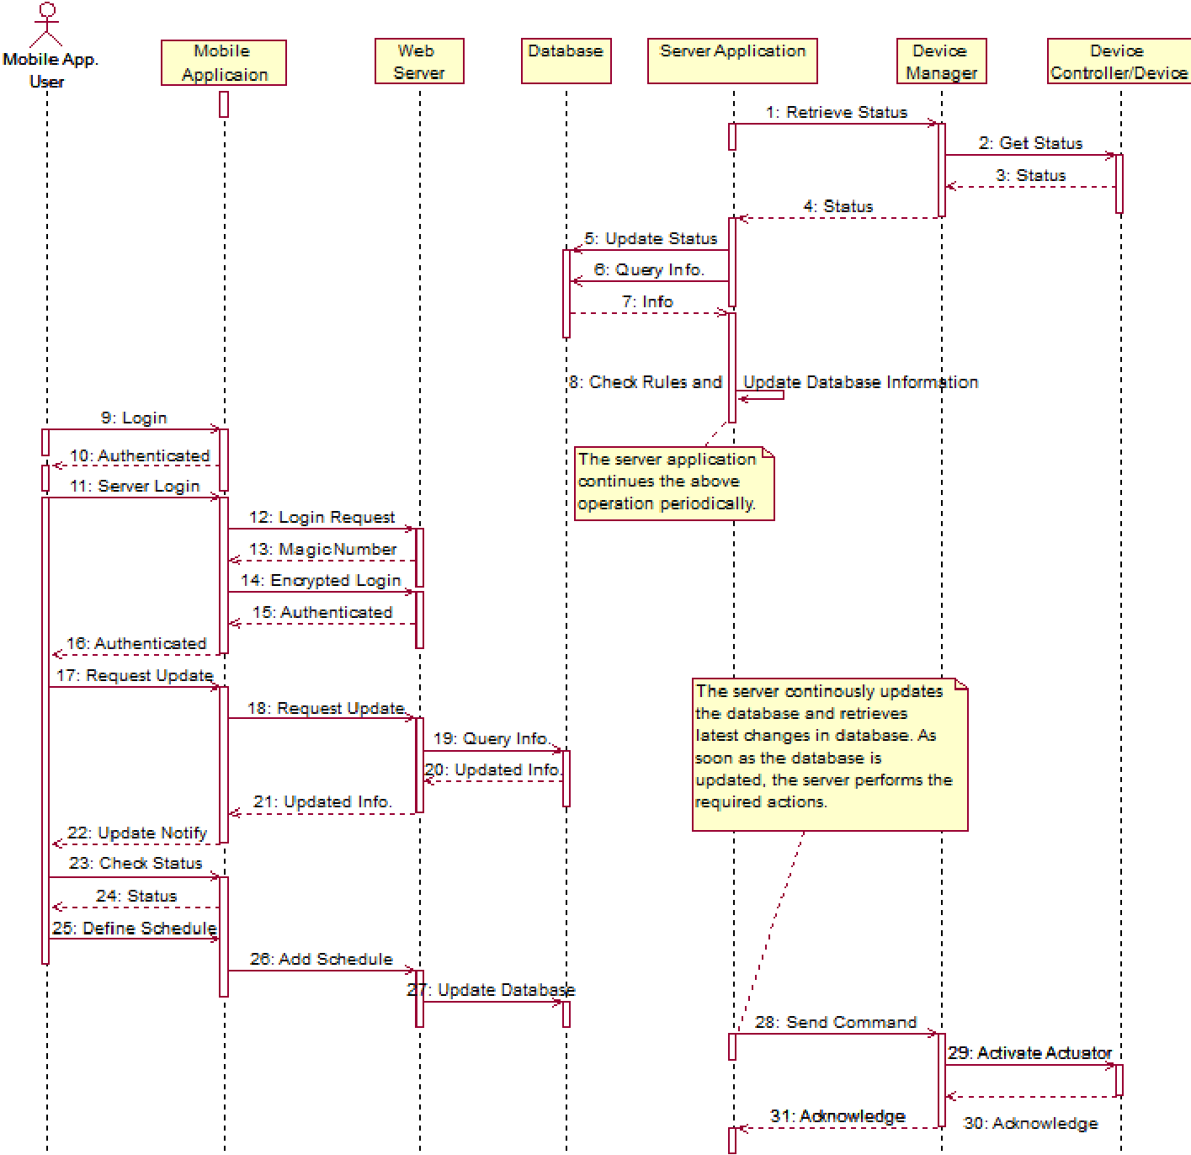
MORE GENERAL FORM

